Slide 1
T311- Material Handler Robot
EEL4911C
VDR2
13-Nov-20

Slide 2

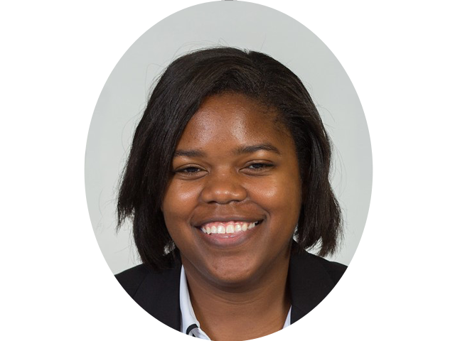





Team Introductions
WALTER CALDWELL
Project Manager
TIFFANY
MILLER
Hardware Engineer
SEBASTIAN MURIEL
System Engineer
ALEX JEN
Software Engineer
TONY ZHENG
Financial Advisor

Slide 3


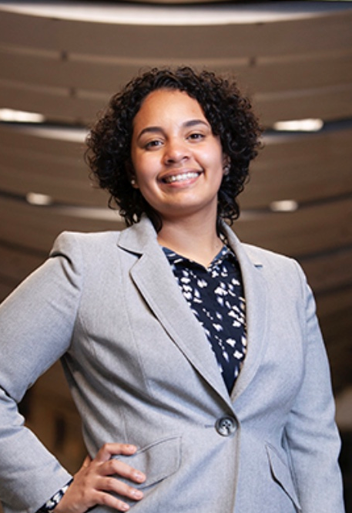


ME Senior Design Team 506
NICHOLAS NORWOOD
Controls Engineer
PETER WATSON
Materials Engineer
DIANDRA REYES
Additive Manufacturing Engineer
ALEXANDER WOZNY
Systems Engineer
TAYLOR HARVEY
Mechanical Design Engineer

Slide 4




Outline
Objective
Concept Generation
Concept Selection
Bill of Materials
Review
Key Goals
Morphological Chart
Concept Evolution
Fidelity Ideas
Requirement Analysis
Pugh Charts
Pairwise Comparisons
Analytic Hierarchy Process
Final Selections

Slide 5
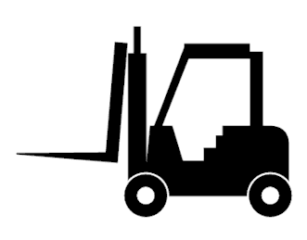
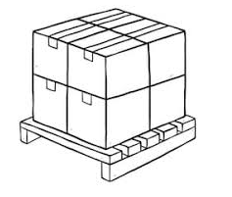
Objective
The objective of this project is to create a partially autonomous material handling robot that works in a dark warehouse with conditions unfavorable to human workers.

Slide 6
Key Goals
Autonomous navigation of the modified warehouse.
Pick up and move boxes up to 25 lbs.
Identify packages using QR codes.
Track inventory using QR codes.
Be able to perform the key tasks in a modified warehouse with low lighting.
Notes:
Explicitly state that these are the minimum requirements for the robot to be considered a success.

Slide 7


Concept Generation

Slide 8
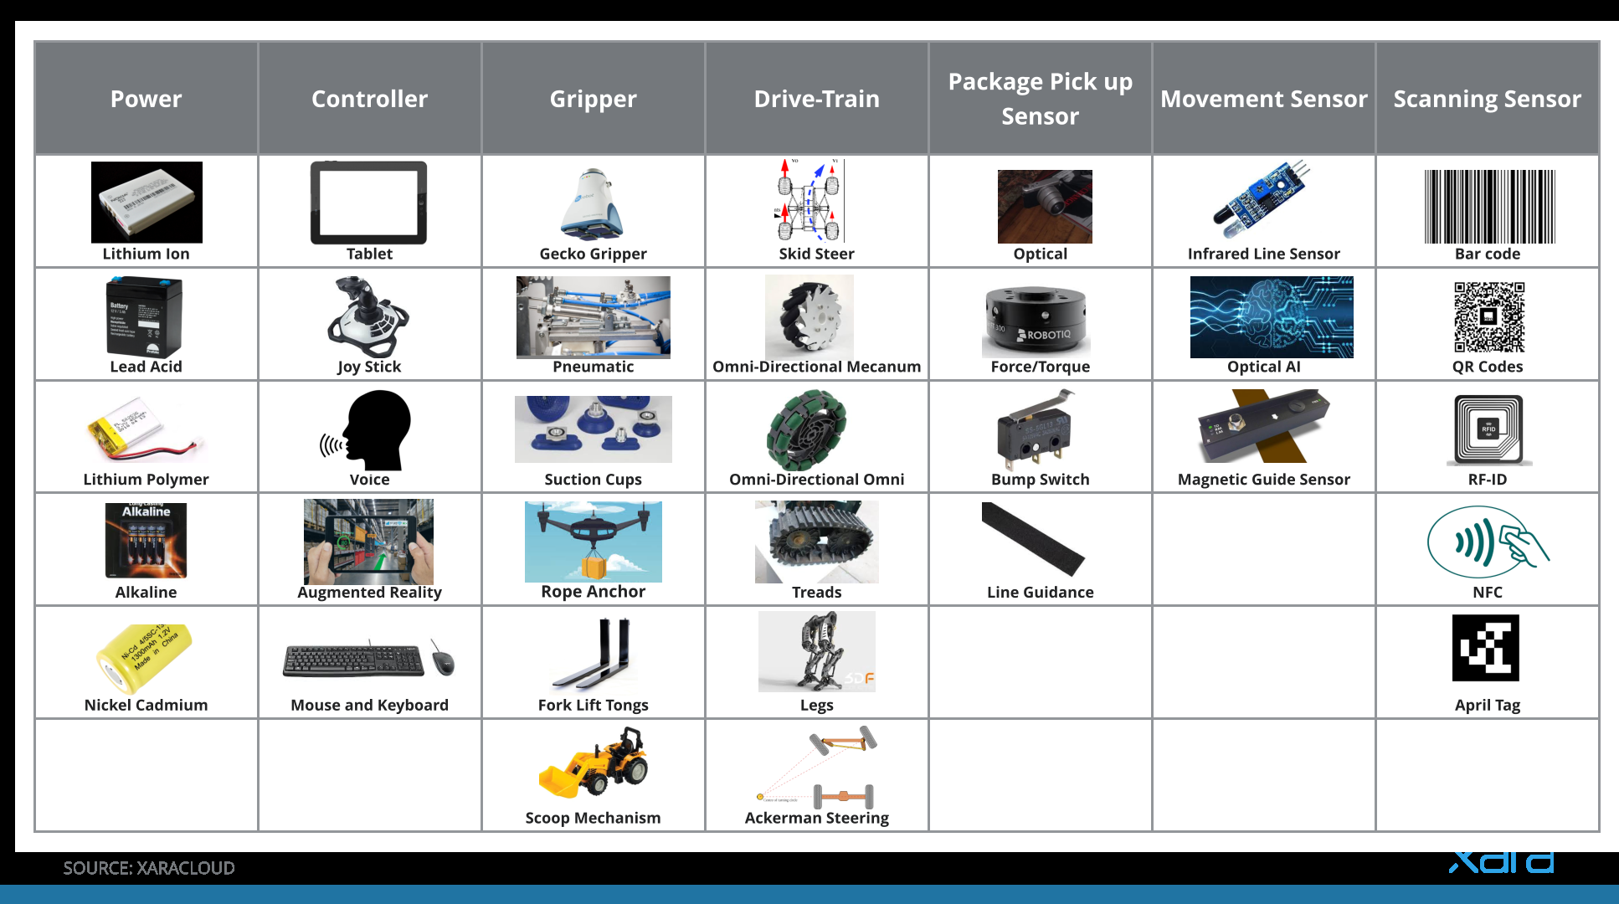
Morphological Chart

Slide 9

Concept Evolution
Take concepts and combine them into different, higher fidelity ideas.
Envision a functioning prototype of each high fidelity concept.
Consider the feasibility of each concept.
Compare the high fidelity concepts with customer needs and targets.
Determine important criteria to be met.
Compare each idea against each other.

Slide 10
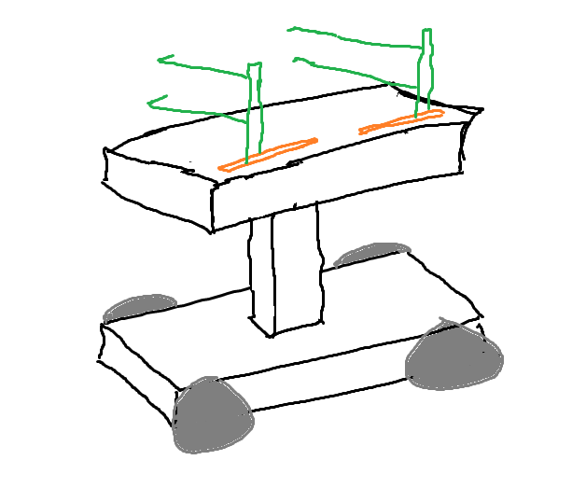
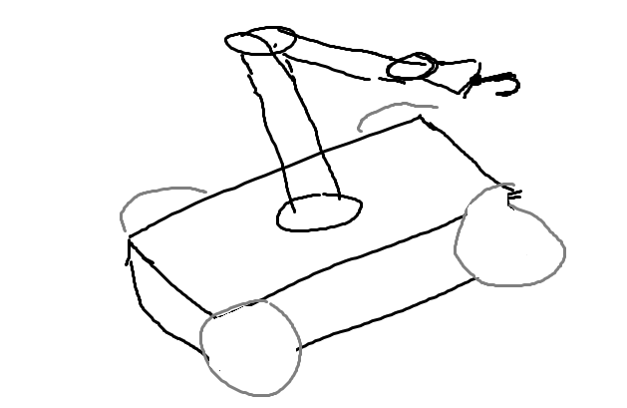
Fidelity Ideas
Orange: Horizontal Movement of arms
Green: Rack and Pinion with bump switches to slide the package onto the top of the robot
Top base extends up and down like a cherry picker to get different levels
-------------------------------------------------
Long arm to reach multiple heights
Packages are equipped with a space to be hooked on by the arm
Camera attached to the robots arm for calculating gripping
-------------------------------------------------

Slide 11

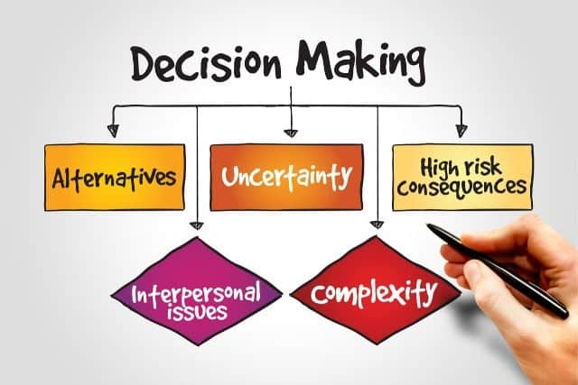
Concept Selection

Slide 12
Requirement Analysis
 |  |  | Engineering Requirements
 |  |  | Cost | Lift Force | Power Motors | Safety | Battery Life | Creates Path | Error Calls
 |  |  | - | + | + | + | + | + | +
Customer Needs | Cost | - | ↑↑ | ↓ | ↓ | ↑ | ↓
 | Safety | + | ↑ | ↓ |  | ↑↑ |  |  | ↑
 | AGV Autonomy | + | ↑ |  | ↑↑ | ↓ | ↓ | ↑↑
 | Obstacle Avoidance | + |  |  | ↑↑ | ↑ | ↓ | ↑↑
 | Navigation through warehouse | + |  |  | ↑↑ | ↓↓ | ↓↓ | ↑↑
Compares customer needs with engineering targets and requirements.
Gives an idea of the tradeoffs that will be made when considering concepts

Slide 13
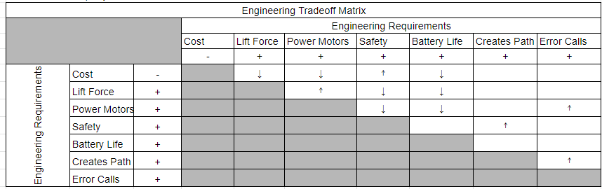
Trade-Off Matrix

Slide 14
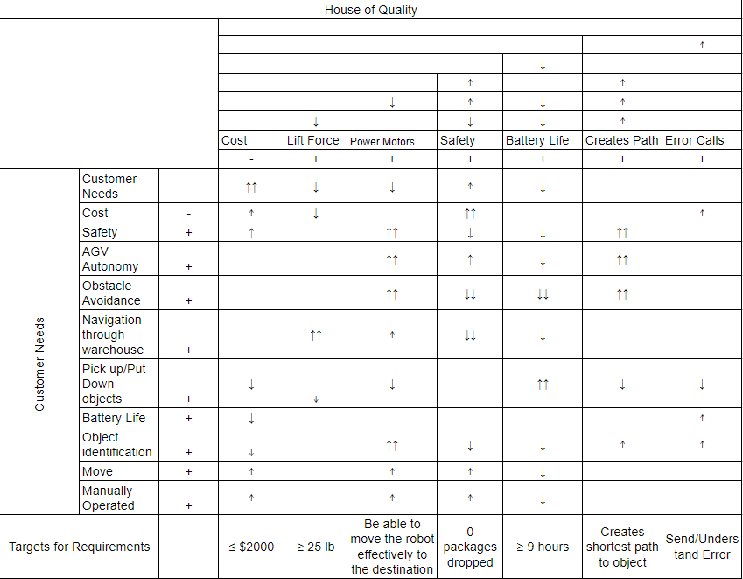
House of Quality

Slide 15
Pugh Charts
 |  | Scanning Sensors
 |  | Barcode | QR Code | RFID Tag | April Tag | NFC Scanner
Storage | 3 | - | 1 | 1 | -1 | 1
Cost | 3 | - | 0 | 0 | 0 | 1
Proximity | 5 | - | 0 | 1 | 0 | -1
Accuracy | 5 | - | 1 | -1 | 0 | 1
Time | 5 | - | 0 | 0 | 0 | 0
Score |  |  | 8 | 3 | -3 | 6
Continue? |  |  | YES | YES | NO | YES
First iteration
Compare to a baseline
Find the best options

Slide 16
Pugh Charts (cont.)
 |  | Scanning Sensors
 |  | QR Code | RFID Tag | NFC Scanner | Barcode
Storage | 3 | - | -1 | 1 | -1
Cost | 3 | - | -1 | -1 | 1
Proximity | 5 | - | 1 | -1 | -1
Accuracy | 5 | - | 0 | 0 | 0
Time | 5 | - | 0 | 0 | 0
Score |  |  | -1 | -5 | -5
Continue? |  | YES | NO | NO | NO
Second iteration
Compare using the best option from the first iteration as baseline
Do a second round of comparison

Slide 17
Pairwise Comparison
Pairwise Comparison
 | Storage | Cost | Proximity | Accuracy | Time | Geom. Mean | Norm. Weight
Storage | 1 | 0.3333333333 | 0.3333333333 | 0.3333333333 | 3 | 0.644394015 | 0.1002079554
Cost | 3 | 1 | 0.3333333333 | 0.2 | 5 | 1 | 0.1555072721
Proximity | 3 | 3 | 1 | 1 | 3 | 1.933182045 | 0.3006238663
Accuracy | 3 | 5 | 1 | 1 | 7 | 2.536517482 | 0.3944469143
Time | 0.3333333333 | 0.2 | 0.3333333333 | 0.1428571429 | 1 | 0.3164738929 | 0.04921399178
Used to determine the ranking of importance of listed criteria
The normalized weights are then used in calculating the consistency indices for each comparison

Slide 18
Analytical Hierarchy Process
 |  | Scanning Sensors
 |  | Barcode | QR Code | RFID Tag | April Tag | NFC Scanner
 | W
Storage | 0.1002079554 | - | 1 | 1 | -1 | 1
Cost | 0.1555072721 | - | 0 | 0 | 0 | 1
Proximity | 0.3006238663 | - | 0 | 1 | 0 | -1
Accuracy | 0.3944469143 | - | 1 | -1 | 0 | 1
Time | 0.04921399178 | - | 0 | 0 | 0 | 0
Score |  |  | 0.4946548697 | 0.006384907505 | -0.1002079554 | 0.3495382755
Uses normalized weights from the consistency indices
More accurately determines the best choice for each concept

Slide 19
Analytical Hierarchy Process (cont.)
 |  | Scanning Sensors
 |  | QR Code | RFID Tag | NFC Scanner | Barcode
 | W
Storage | 0.1002079554 | - | -1 | 1 | -1
Cost | 0.1555072721 | - | -1 | -1 | 1
Proximity | 0.3006238663 | - | 1 | -1 | -1
Accuracy | 0.3944469143 | - | 0 | 0 | 0
Time | 0.04921399178 | - | -1 | 0 | 0
Score |  |  | -0.00430535302 | -0.355923183 | -0.2453245497
The method is applied for both iterations
Confirms the best choice or highlights an inconsistency in concept selection

Slide 20
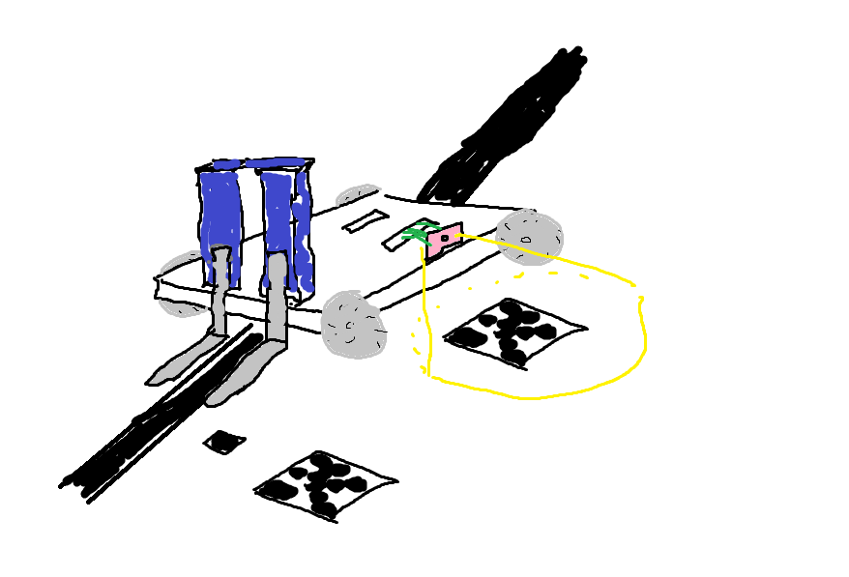
Final Selections
Power
Lithium Ion
Motor
DC Brushless
Pickup Sensor
Tape Guide
Connectivity
Wifi
Drive Train
Omni-Directional Wheels
Movement Sensor
Infrared Scanner
Scanning Sensor
Camera

Slide 21
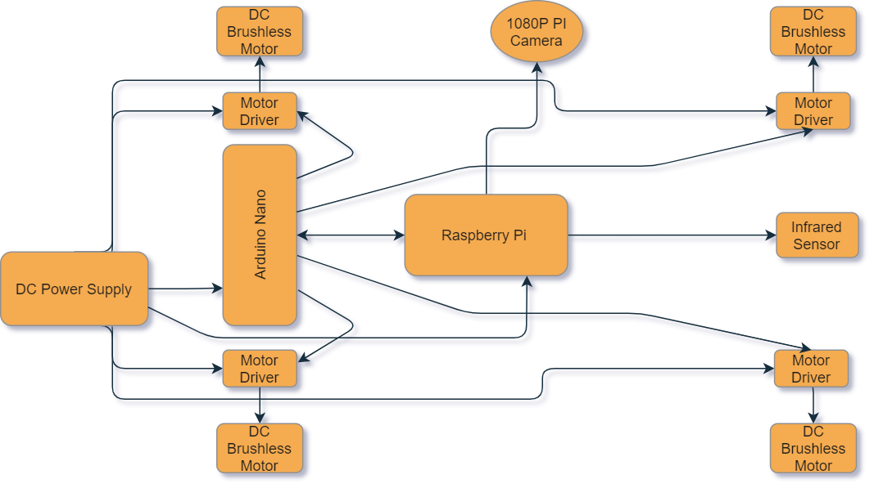
Block Diagram

Slide 22
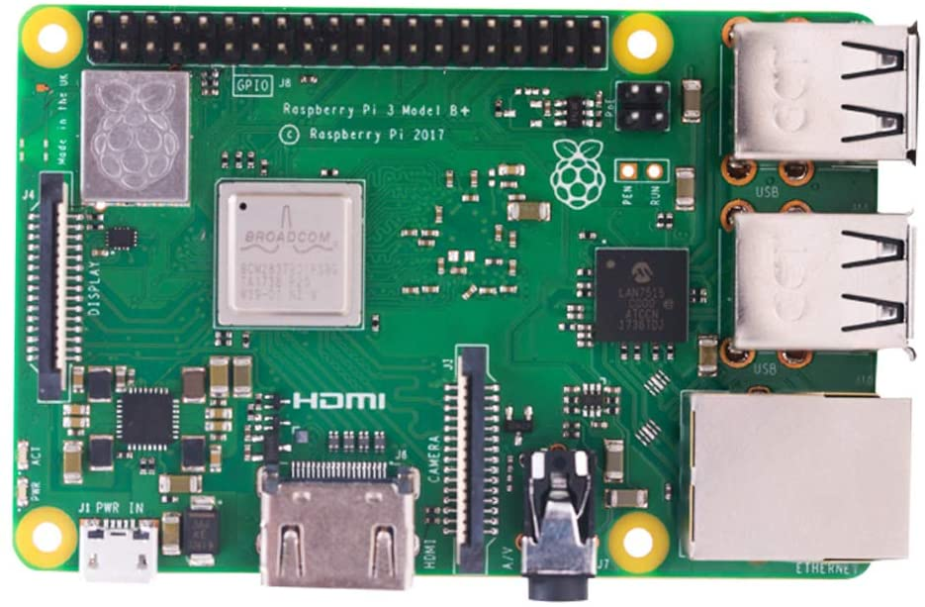
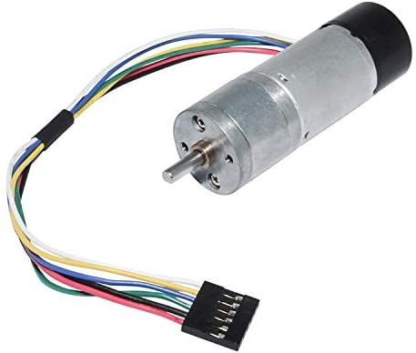
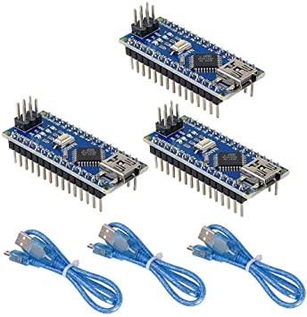
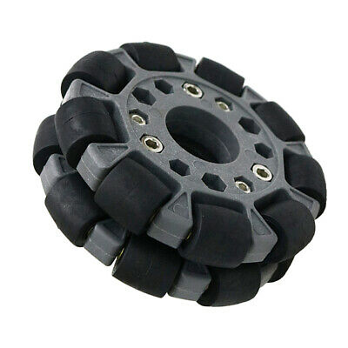
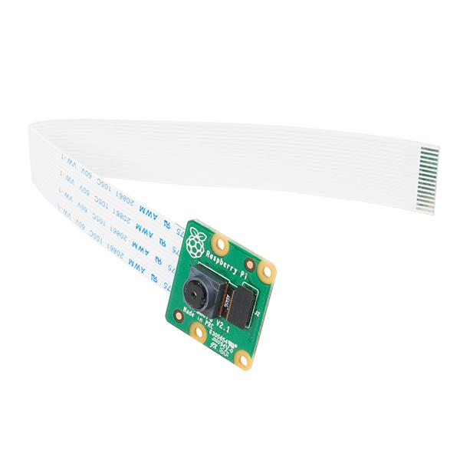
Bill of Materials
BEMONOC DC Gear Motor 12V
Raspberry Pi 3 Model B+ Board
Microprocessor
Omnidirectional Universal Wheels
Pi Camera

Slide 23
Five Most Important Points from this Presentation
We are creating an autonomous robot that will be able to navigate in a dark warehouse
Our robot will be able to pick up and carry boxes up to 25 pounds.
Our robot will be able to correctly identify packages using QR code scanning
Our robot will be able to keep track of inventory using QR code scanning
The robot is a scaled down version to operate in a scaled down environment

Slide 24
References
https://www.jobs-ups.com/job/barre/package-delivery-driver/1187/560416
https://www.osha.gov/SLTC/etools/electricalcontractors/materials/heavy.html#:~:text=Limit%20weight%20you%20lift%20to,the%20load%20(Figure%204).
https://spectrum.ieee.org/robotics/robotics-software/three-engineers-hundreds-of-robots-one-warehouse
https://ieeexplore.ieee.org/abstract/document/8576899
https://ieeexplore.ieee.org/abstract/document/8956454

Slide 25

Questions

